Slide 1
Autoencoder SINDy
Instructor: Mohammad Hasan
Office: 13-240
10/28/26
Notes:
Welcome and Introductions

Slide 2
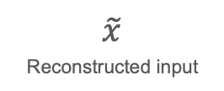
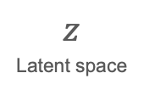
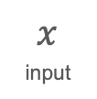
Encoder Architecture
Goal: Summarize input in a low dimensional space (and allow deconstruction of the full input)
Latent space has a much smaller dimension than the input space
Encoder network
Decoder network
$$x$$
input
$$z$$
Latent space
$$\tilde{x}$$
Reconstructed input

Slide 3
Encoder Architecture
Signal should be able to be constructed from the latent space
Nonlinear transformations occur in the encoder block. They should be (close to) inverted in the Decoder block.
Encoder network
Decoder network
$$x$$
input
$$z$$
Latent space
$$\tilde{x}$$
Reconstructed input

Slide 4
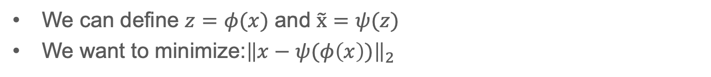
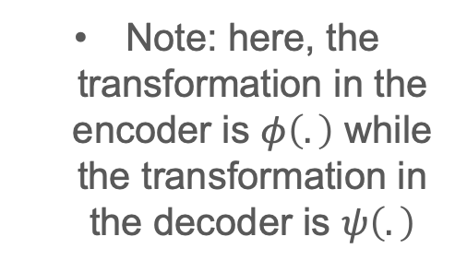
Autoencoder Optimization Problem
We can define $z=φ(x)$ and $\tilde{x}=ψ(z)$
We want to minimize:${\left\|x−ψ(φ\left(x\right))\right\|}_{2}$
We can perform regularization in the minimization problem.
Encoder network
Decoder network
Note: here, the transformation in the encoder is $φ\left(.\right)$ while the transformation in the decoder is $ψ\left(.\right)$
$$x$$
input
$$z$$
Latent space
$$\tilde{x}$$
Reconstructed input

Slide 5
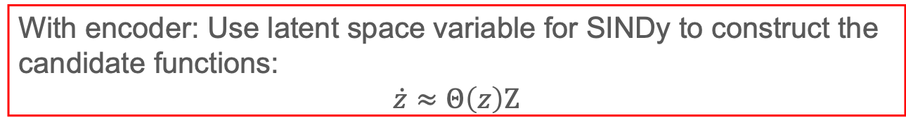
SINDy with Autoencoder Architecture
We can use the SINDy algorithm with data from the latent space
Original Approach: Use for SINDy to construct the candidate functions:
$$\dot{x}≈Θ\left(x\right)Ζ$$
With encoder: Use latent space variable for SINDy to construct the candidate functions:
$$\dot{z}≈Θ\left(z\right)Ζ$$
Using data from the latent space gives us a chance to discover the dynamics of a system in a more automated fashion.
Some of the nonlinear transformations are done in the encoder block.

Slide 6
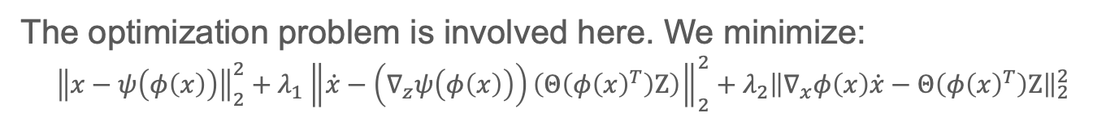
Loss of Autoencoder + SINDy
The optimization problem is involved here. We minimize:
$${\left\|x−ψ\left(φ\left(x\right)\right)\right\|}_{2}^{2}+λ_{1}{\left\|\dot{x}−\left(∇_{z}ψ\left(φ\left(x\right)\right)\right)\left(Θ\left(φ{\left(x\right)}^{T}\right)Ζ\right)\right\|}_{2}^{2}+λ_{2}{\left\|∇_{x}φ\left(x\right)\dot{x}−Θ\left(φ{\left(x\right)}^{T}\right)Ζ\right\|}_{2}^{2}$$
Error in autoencoder reconstruction
Error in constructing the differential equation for $\dot{x}$ from the architecture using $x$, and $z$
Error in constructing the differential equation for $\dot{z}$ from the architecture using $x$, and $z$

Slide 7
Conclusion
Autoencoders allow for the summarization of input information.
Autoencoders can be used in conjunctions with SINDy for system identification. This can help us find the differential equation even if the function library is missing a function.
The flip side of the previous point is that we lose some physical meaning to the derived differential equation
Reducing the input space can be beneficial in some applications where the input space might be extremely big (Sensor array, images).

Slide 8
Further reading
Champion et al., “Data-driven discovery of coordinates and governing equations” (2019)
Bakarji et al., “Discovering Governing Equations from Partial Measurements with Deep Delay Autoencoders” (2022)
Conti et al., “Reduced order modeling of parametrized systems through autoencoders and SINDy approach” (2023)

Slide 9
References
Autoencoder:
Data-Driven Science and Engineering, Machine Learning, Dynamical Systems, and Control. S. Brunton and J. Kutz, Second Edition. Section 6.8.
SINDy:
Data-Driven Science and Engineering, Machine Learning, Dynamical Systems, and Control. S. Brunton and J. Kutz, Second Edition. Section 7.3.
SINDy Autoencoder:
Data-Driven Science and Engineering, Machine Learning, Dynamical Systems, and Control. S. Brunton and J. Kutz, Second Edition. Section 14.2.

Slide 10
Extra notes

